Slide 1
An introduction to Integral Projection Models (IPMS)
Cory Merow
Rob Salguero-Gomez
Eelke Jongejans
Sean McMahon
Jessica Metcalf
Notes:
My goal is to bridge the gap between the concepts underlying ipms, and developing an understanding of how to actually build the models

Slide 2
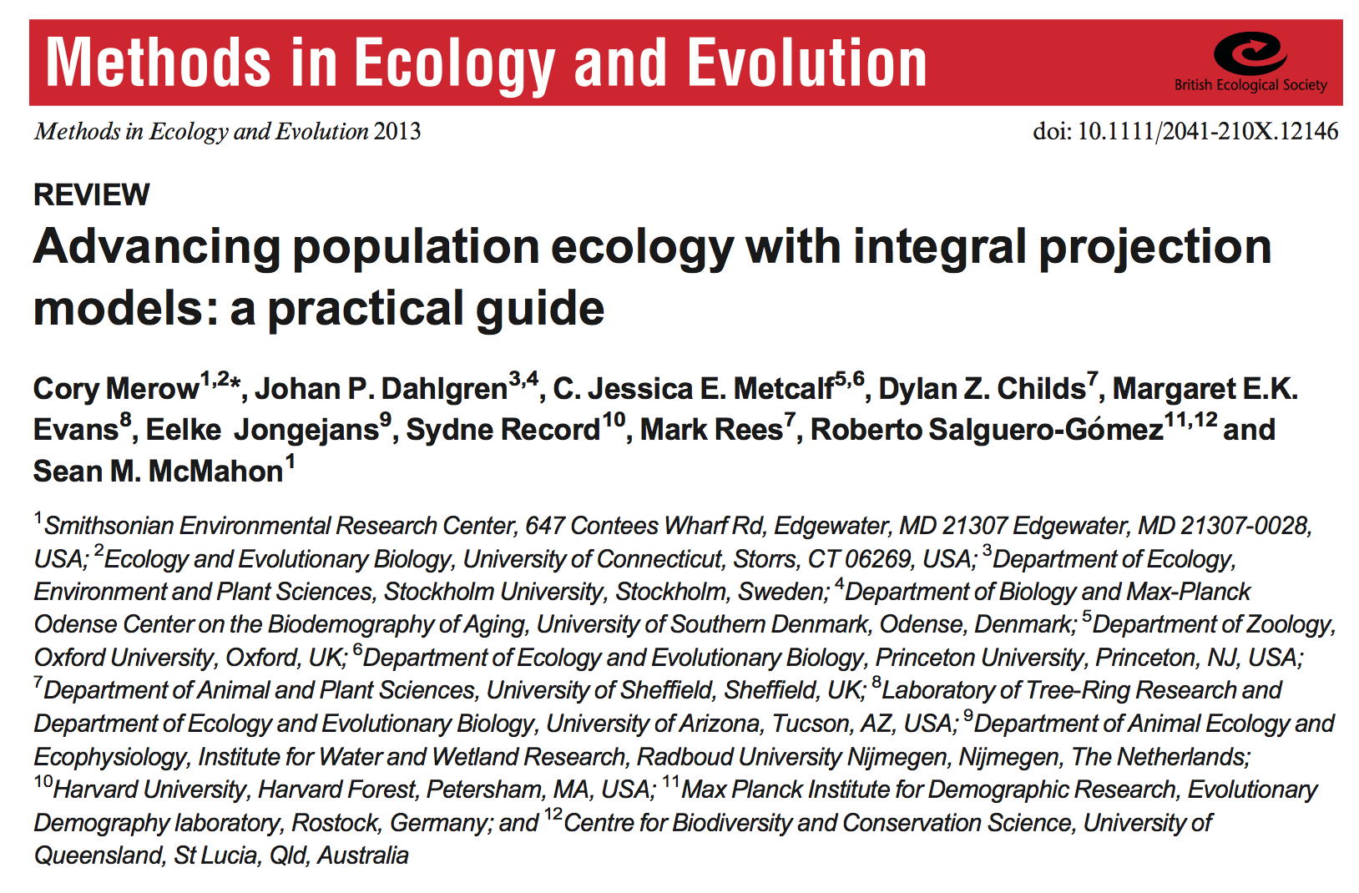

Slide 3
IPMs
Expand,
with
graphics
Process-based demography:
Accurate stage structure
Decompose life history to desired level of detail
Link vital rates to covariates
Heterogeneity among individuals
Notes:
Add plot of IPMs through time from website
Not dividing into arbitrary classes
3. Types of covariates
This helps us to understand and explain the processes driving population level, rather than just describe them

Slide 4
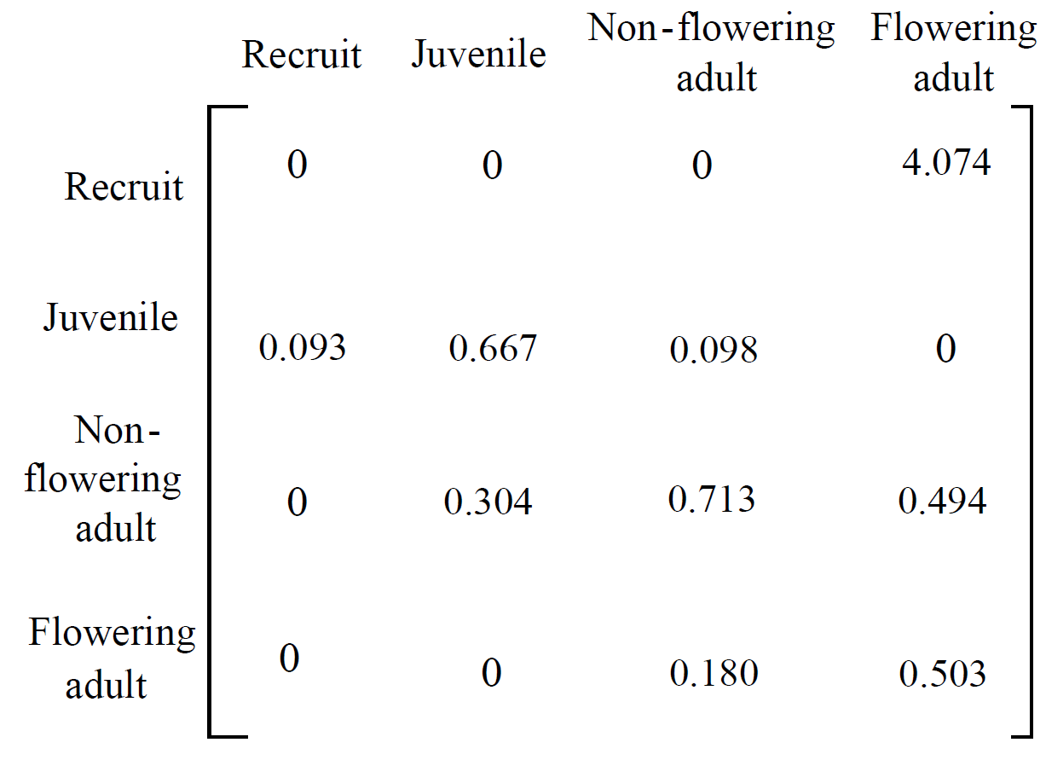
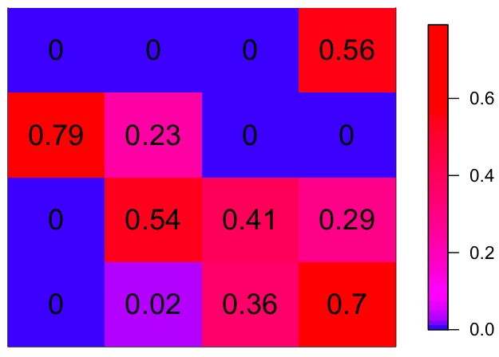
What is an IPM?
Lefkovich matrix for a long-lived perennial shrub
Time t
Transition
Probability
Time t+1
Notes:
Observations of individuals demographic transitions between stages
Takes population structure this year and describes structure next year
One of the issues is the discretization
Color coding indicates the magnitude of the value.

Slide 5
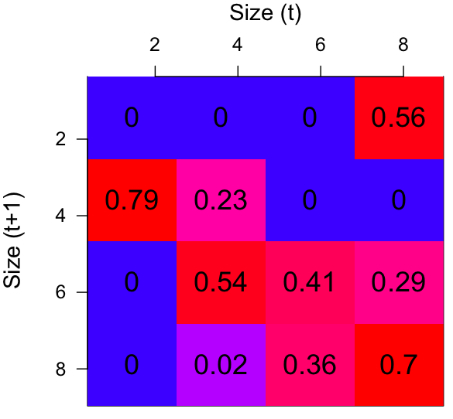
What is an IPM?
time t
Transition
Probability
Could change color scheme
And .56 to 1.2
50
23
14
23
18
13
14
48
time
t+1
=
Notes:
Observations of individuals demographic transitions between stages
Takes population structure this year and describes structure next year
Point out what you can caluculate: population growth, size distribuion, passage times, senstivities, forecasting dynamics

Slide 6
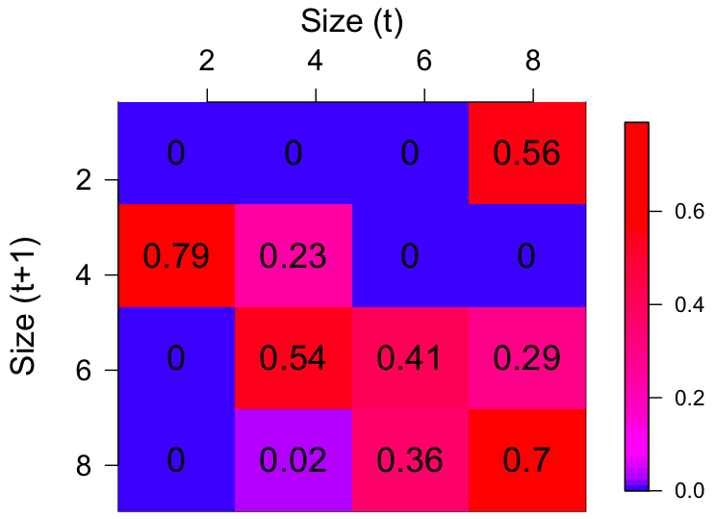
What is an IPM?
Transition
Probability
Notes:
Let’s rather use a continuous state variable, which I’ll call size.
One of the issues is the discretization
If we had more data, we might try to make this more biologically realistic and include more stages.

Slide 7
What is an IPM?
Transition Probability
More stages = more heterogeneity among individuals
Notes:
Higher resolution better for capturing variability among individuals – not assuming everyone in a big cell is the same

Slide 8
What is an IPM?
Matrix models and IPMs arrive at matrices for different reasons
Notes:
More stages = more heterogeneity among individuals
we call this the kernel and it describes everything we need to know about the model
How do we parameterize? With regressions

Slide 9
Workflow
Life History
Vital Rate Regressions
IPM Kernel
Analysis
Data
Notes:
To understand how this all fits together, i’ll

Slide 10
Workflow
Life History
Vital Rate Regressions
IPM Kernel
Analysis
Data

Slide 11
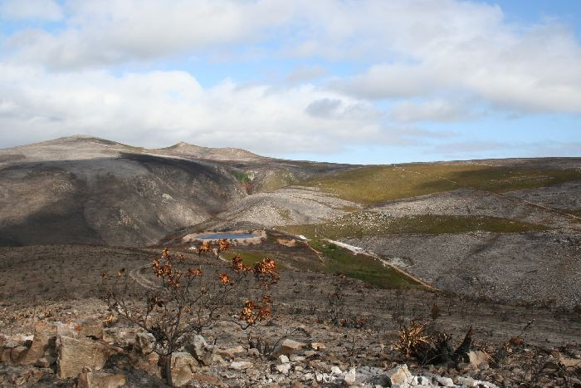
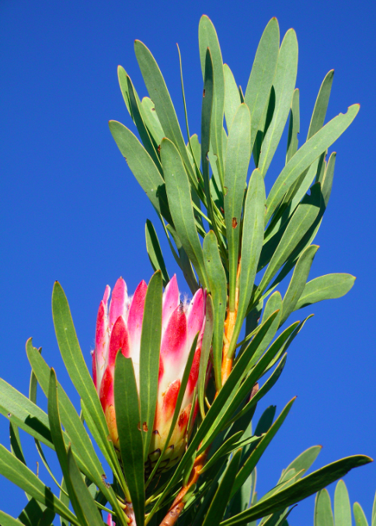

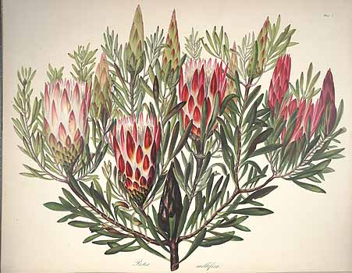

Life history
growth
germination
time
survival
germinant
survival
fecundity
flowering probability

Slide 12
Workflow
Life History
Vital Rate Regressions
IPM Kernel
Analysis
Data

Slide 13
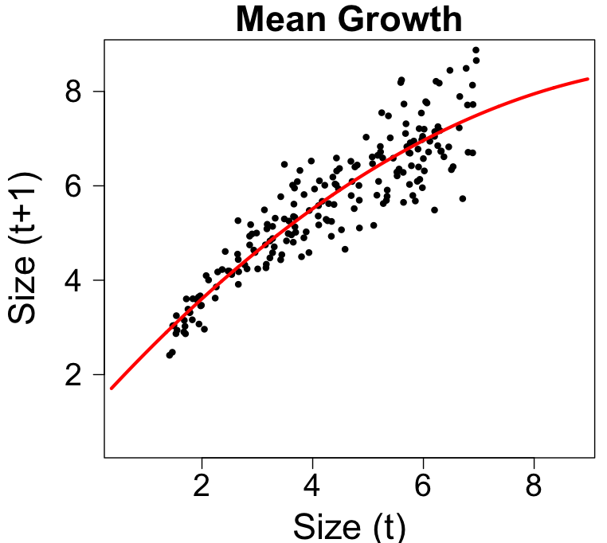
Data: Growth

Slide 14
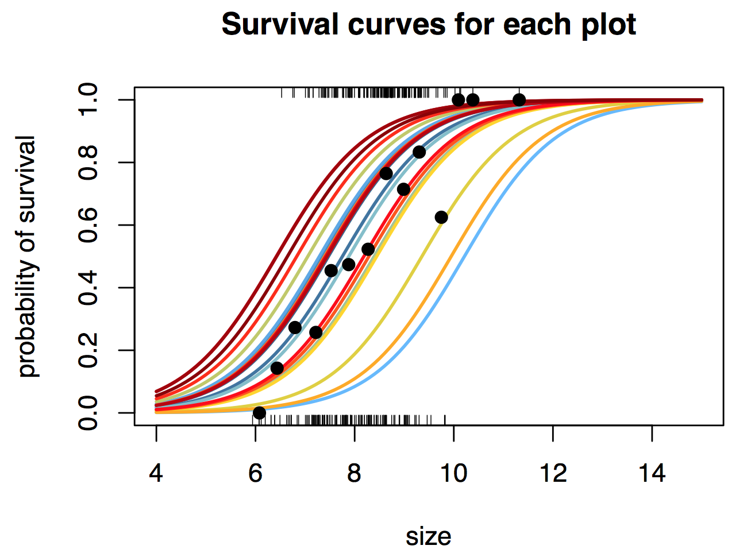
Data: Survival

Slide 15
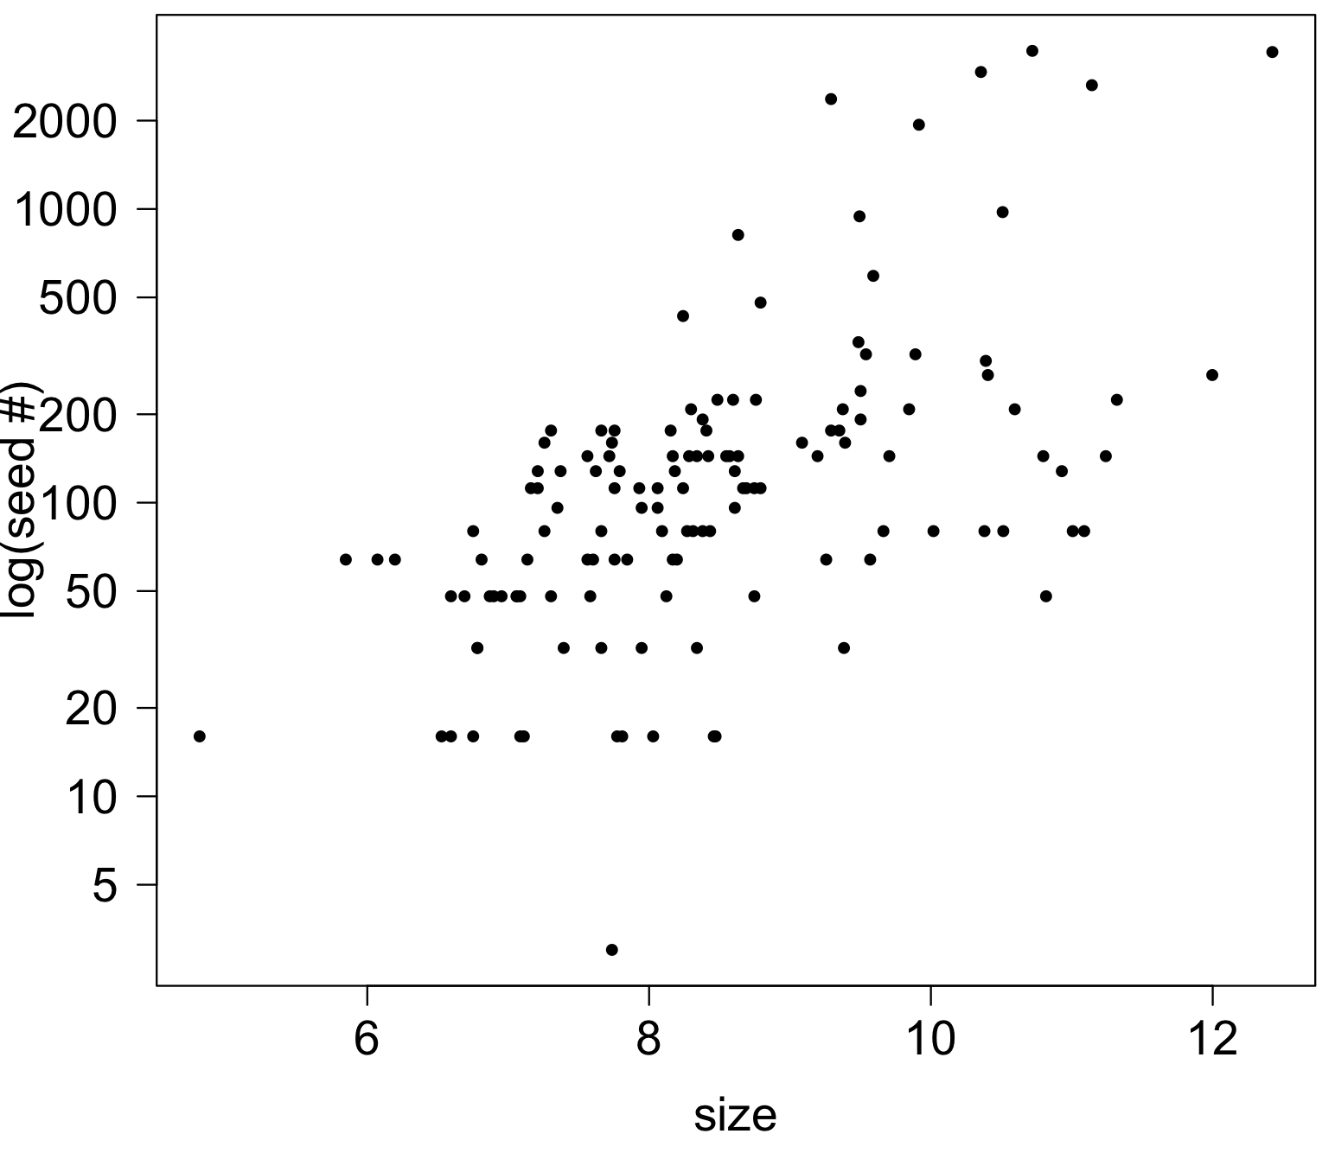
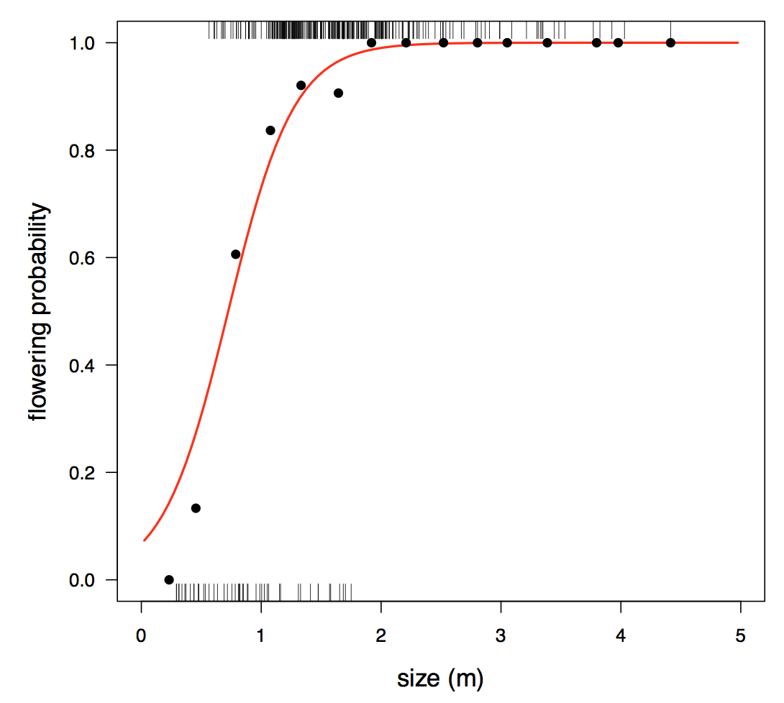
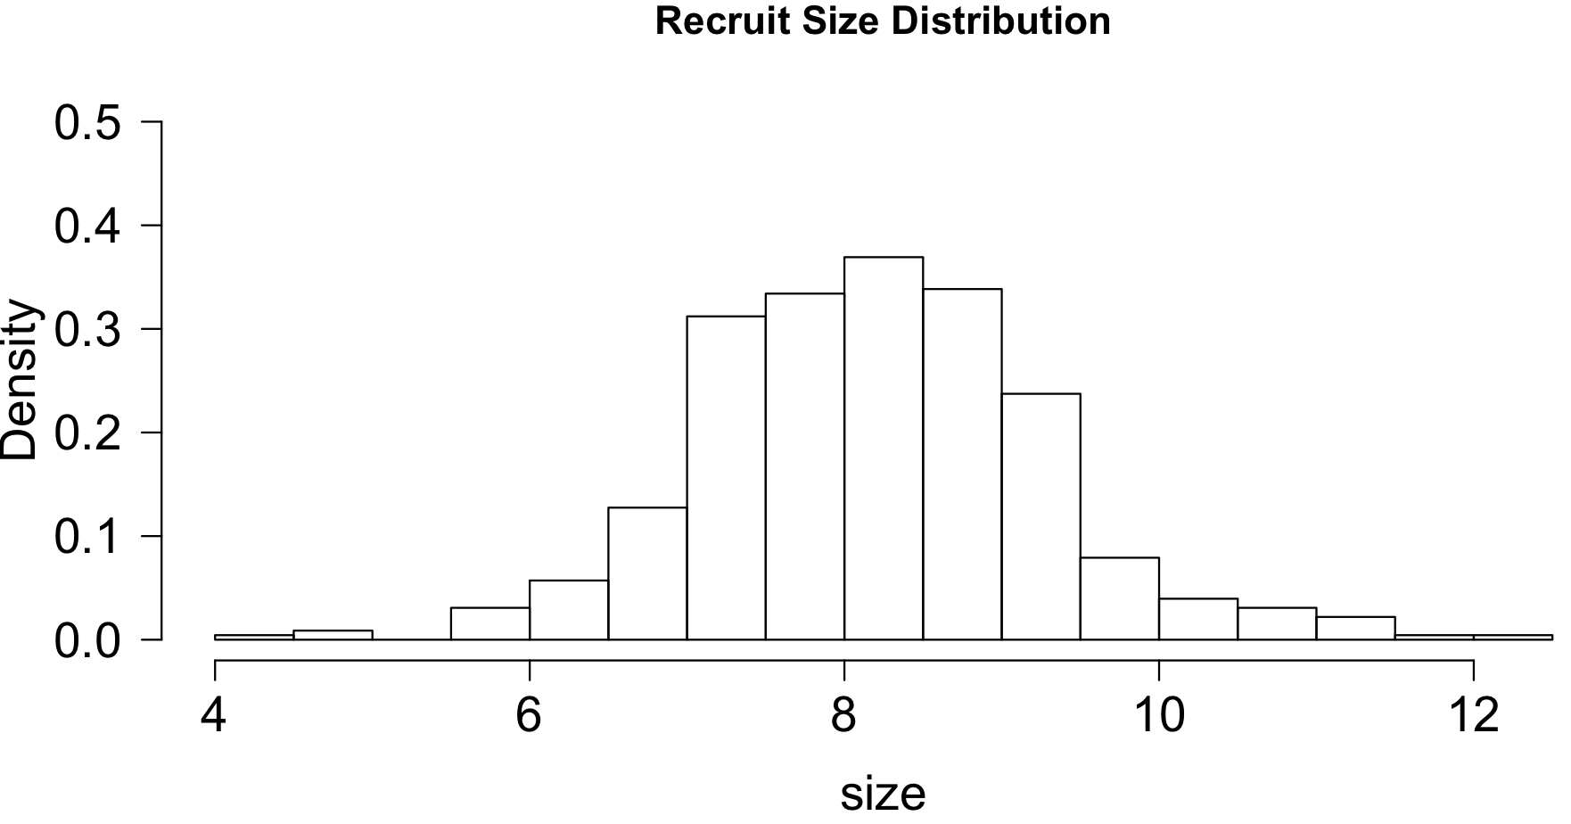
Data: Fecundity
Germination probability

Slide 16
Workflow
Life History
Vital Rate Regressions
IPM Kernel
Analysis
Data

Slide 17
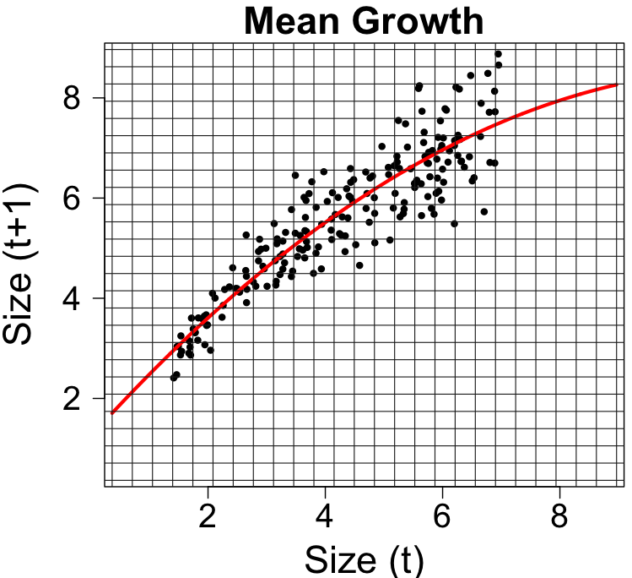
Vital Rate Regression: Growth
Notes:
We’ll go into some detail on the growth regression

Slide 18
Vital Rate Regression: Growth

Slide 19
Vital Rate Regression: Growth

Slide 20
Vital Rate Regression: Growth
Full kernel

Slide 21
Workflow
Life History
Vital Rate Regressions
IPM Kernel
Analysis
Data
Notes:
To understand how this all fits together, i’ll

Slide 22
The model
t = time
x = size at t
y = size at t+1
n_{t}(x) = size distribution at t
n_{t+1}(y) = size distribution at t+1
K(x,y) = full kernel
P(x,y) = growth/survival kernel
F(x,y) = fecundity kernel
Number of
individuals
of each size

Slide 23
The model
t = time
x = size at t
y = size at t+1
n_{t}(x) = size distribution at t
n_{t+1}(y) = size distribution at t+1
K(x,y) = full kernel
P(x,y) = growth/survival kernel
F(x,y) = fecundity kernel

Slide 24
The model
t = time
x = size at t
y = size at t+1
n_{t}(x) = size distribution at t
n_{t+1}(y) = size distribution at t+1
K(x,y) = full kernel
P(x,y) = growth/survival kernel
F(x,y) = fecundity kernel
Notes:
Instead of matrix multiplication, it’s integration

Slide 25
The model
t = time
x = size at t
y = size at t+1
n_{t}(x) = size distribution at t
n_{t+1}(y) = size distribution at t+1
K(x,y) = full kernel
P(x,y) = growth/survival kernel
F(x,y) = fecundity kernel
50
23
14
23
18
13
14
48
=
Notes:
Instead of matrix multiplication, it’s integration

Slide 26
The model
t = time
x = size at t
y = size at t+1
n_{t}(x) = size distribution at t
n_{t+1}(y) = size distribution at t+1
K(x,y) = full kernel
P(x,y) = growth/survival kernel
F(x,y) = fecundity kernel
Notes:
Instead of matrix multiplication, it’s integration

Slide 27
The model
t = time
x = size at t
y = size at t+1
n_{t}(x) = size distribution at t
n_{t+1}(y) = size distribution at t+1
K(x,y) = full kernel
P(x,y) = growth/survival kernel
F(x,y) = fecundity kernel

Slide 28
Life History
Example 1: Long-lived perennial plant
P(x,y) = (survival probability at size x) * (growth from x to y)
= s(x) * g(x,y)
Notes:
P(x,y) and F(x,y) decomposed into vital rate functions
g(x,y) = probability that size x individuals who survive grow to size y
Encompasses growth stasis and retrogression

Slide 29
Life History
Example 1: Long-lived perennial plant
P(x,y) = (survival probability at size x) * (growth from x to y)
= s(x) * g(x,y)
F(x,y) = (mean # seeds of size x parent) *
(establishment probability)
(probability of size y offspring from size x parent)
= f_{seeds}(x) * p_{estab}*f_{recruit}(y)

Slide 30
Life History
Example 1: Long-lived perennial plant
P(x,y) = (survival probability at size x) * (growth from x to y)
= s(x) * g(x,y)
F(x,y) = (mean # seeds of size x parent) *
(establishment probability)
(probability of size y offspring from size x parent)
= f_{seeds}(x) * p_{estab} * f_{recruit}(y)

Slide 31
Life History
Example 1: Long-lived perennial plant
P(x,y) = (survival probability at size x) * (growth from x to y)
= s(x) * g(x,y)
F(x,y) = (mean # seeds of size x parent) *
(establishment probability)
(probability of size y offspring from size x parent)
= f_{seeds}(x) * p_{estab} * f_{recruit}(y)

Slide 32
Life History
Example 2: Monocarpic perennial
P(x,y) = ([not] flowering probability of size x parent)*
(survival probability at size x) * (growth from x to y)
= [1-p_{flower}(x)] * s(x) * g(x,y)
Notes:
Flowering implies death
It had to not flower last year and survive the winter. We could lump all the death due to flowering into survival, but then we wouldn’t disentagnle factors that affect flowering vs those that affect survival

Slide 33
Life History
Example 2: Monocarpic perennial
P(x,y) = ([not] flowering probability of size x parent)*
(survival probability at size x) * (growth from x to y)
= [1-p_{flower}(x)] * s(x) * g(x,y)
F(x,y) = (flowering probability of size x parent)*
(mean # recruits of size x parent) *
(establishment probability)*
(probability of size y offspring from size x parent)
= p_{flower}(x) * f_{recruits}(x) *p_{estab} * f_{recruit}(y)
Notes:
Given sufficient data, what other functions might you further decompose here? Establishment -> probability of seed survival * prob germination * prob esablish

Slide 34
Life History
Example 2: Monocarpic perennial
P(x,y) = ([not] flowering probability of size x parent)*
(survival probability at size x) * (growth from x to y)
= [1-p_{flower}(x)] * s(x) * g(x,y)
F(x,y) = (flowering probability of size x parent)*
(mean # recruits of size x parent) *
(establishment probability)*
(probability of size y offspring from size x parent)
= p_{flower}(x) * f_{recruits}(x) *p_{estab} * f_{recruit}(y)

Slide 35
Workflow
Life History
Vital Rate Regressions
IPM Kernel
Analysis
Data

Slide 36
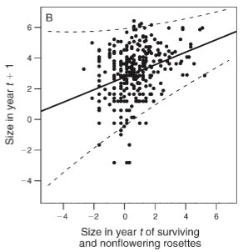
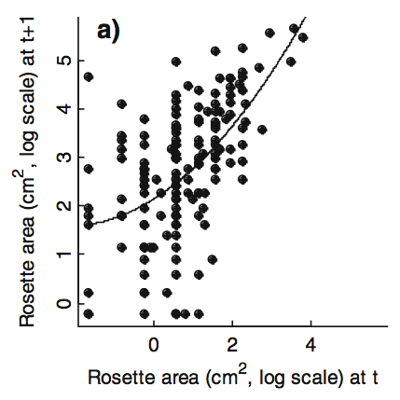
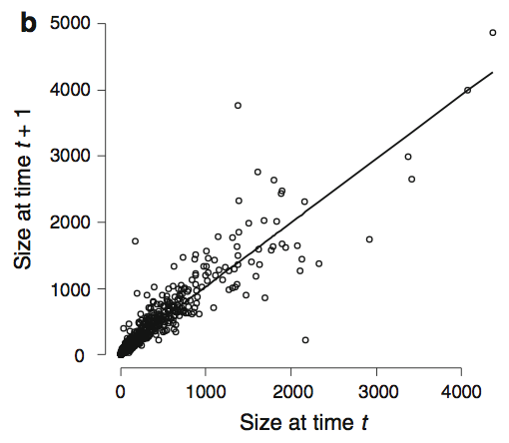
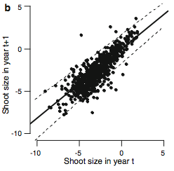
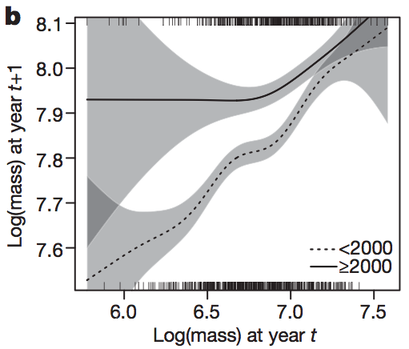
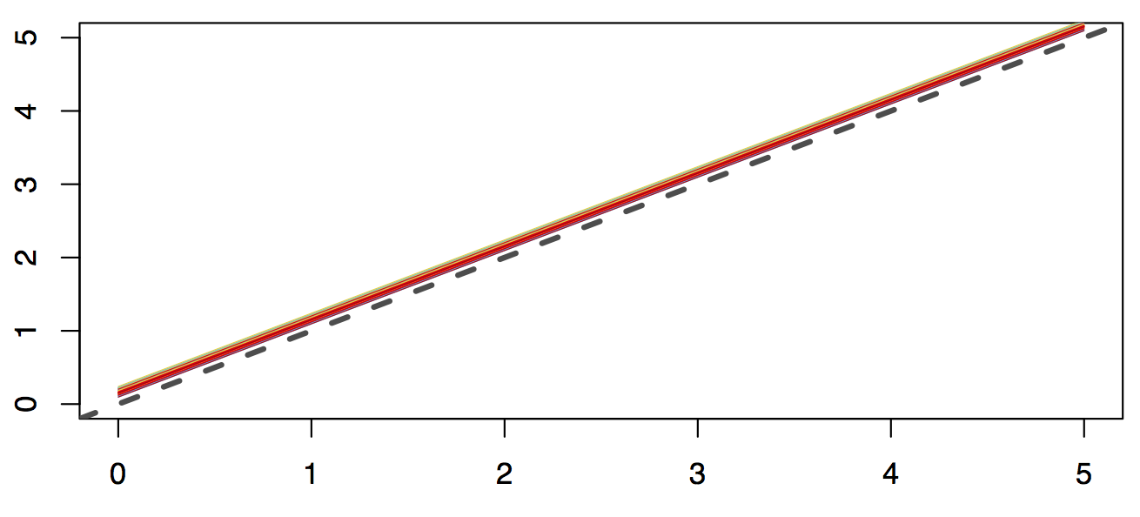
Vital Rate Regression: Growth – g(x,y)
Jongejans et al. 2011
Metcalf et al. 2008
Ferrer-Cervantes et al. 2012
Size (t+1)
Hegland et al. 2010
Merow et al. 2014
Ozgul et al. 2010
Size (t)
Notes:
Explain axes
Note constant (boring) growth from merow
Note GAMs from Ozgul; better have a good reason for those wiggles or you’ll end up with cycles

Slide 37
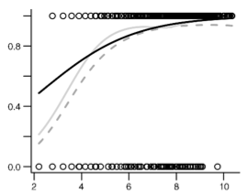
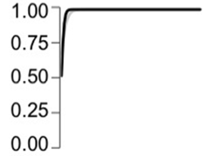
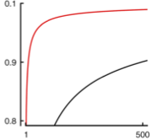
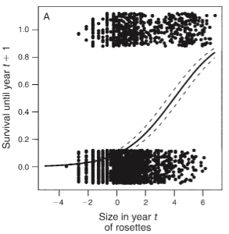
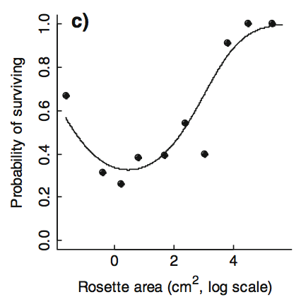
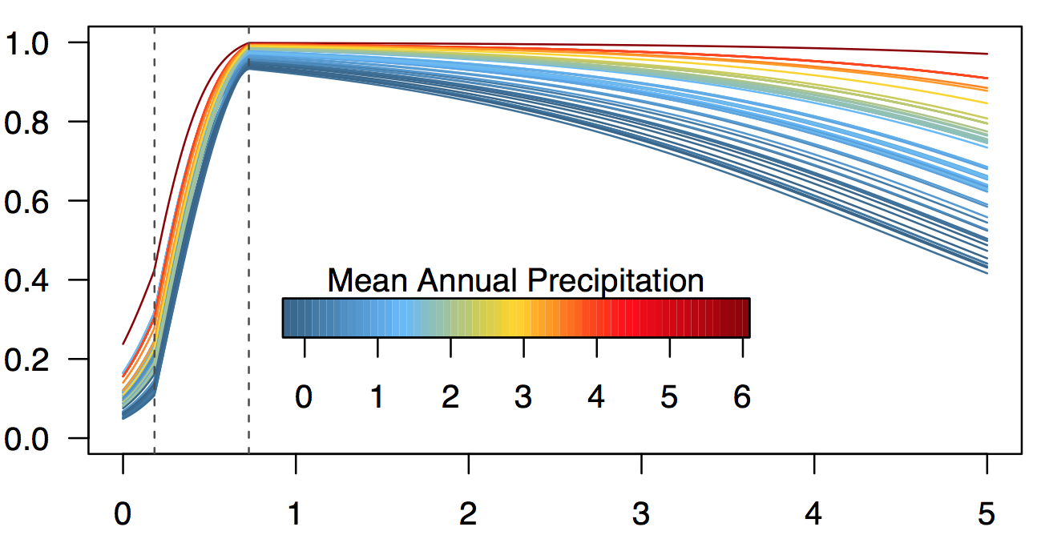
Vital Rate Regression: Survival – s(x)
Dahlgren et al. 2011
Salguero-Gomez et al. 2012
Metcalf et al. 2009
Survival Probability
Jongejans et al. 2011
Merow et al. 2014
Metcalf et al. 2008
Size
Notes:
S(x) needs 1s and 0s.

Slide 38
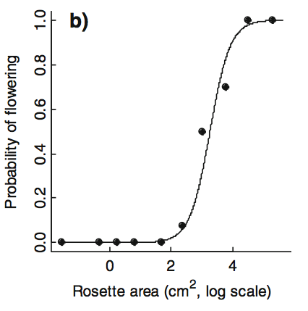
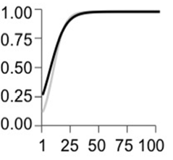
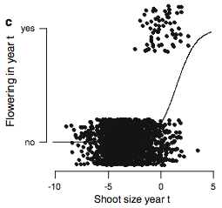
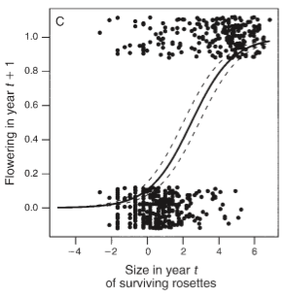
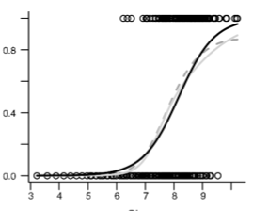
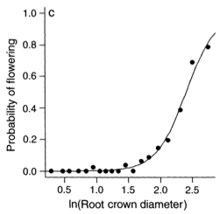
Vital Rate Regression: Flowering – p_{flower}(x)
Metcalf et al. 2008
Salguero-Gomez et al. 2012
Hegland et al. 2010
Flowering Probability
Jongejans et al. 2011
Dahlgren et al. 2011
Rose et al. 2005
Size

Slide 39
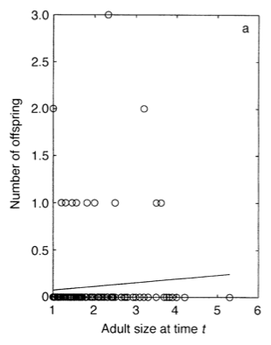
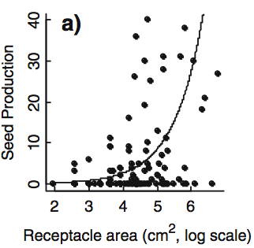
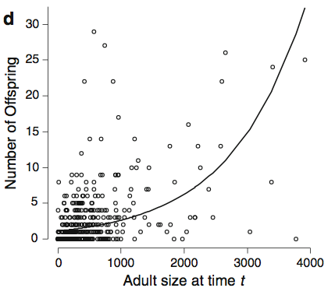
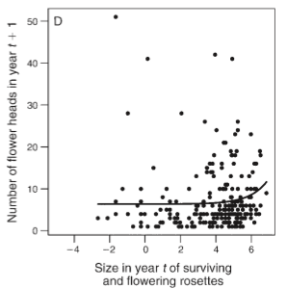
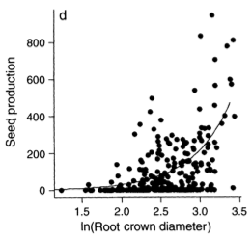
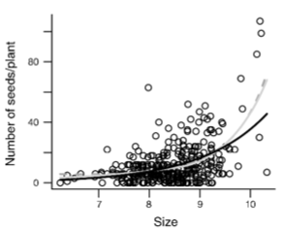
Vital Rate Regression: Fecundity – f_{seeds}(x)
Easterling et al. 2000
Metcalf et al. 2009
Ferrer-Cervantes et al. 2012
Number of Babies
Jongejans et al. 2011
Rose et al. 2005
Dahlgren et al. 2011
Size
Notes:
Usually Poisson regression
Different measures – seeds, recruits, flower heads
Any number of other functions that you might break recruitment into – germination, establishment

Slide 40
Vital Rate Regression: Fecundity – f_{recruit}(x,y)

Slide 41
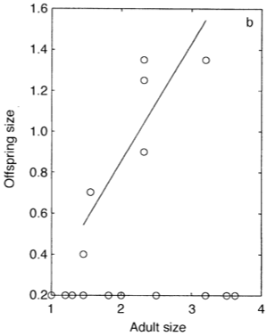
Vital Rate Regression: Fecundity – f_{recruit}(x,y)
Easterling et al. 2000
Notes:
Often only a function of y
Or clonal growth, in which case you might use a mixture of two distributions

Slide 42
Workflow
Life History
Vital Rate Regressions
IPM Kernel
Analysis
Data
Notes:
To understand how this all fits together, i’ll

Slide 43
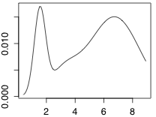
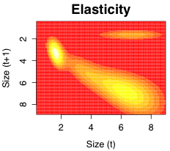
Analysis
Want the same things from IPMs as from matrix models
Eigenvalues
Eigenfunction (vectors)
Can do all the same analyses with IPMs as matrix models
Elasticity/sensitivity
Forward projections
Stochastic dynamics
Life table response experiments
Passage time, Life expectancy
Etc…
λ
Notes:
To perform these analyses, we need to integrate
TODO: make examples more visual and connected to case studies
TODO: Maybe split the analysis talk off to allow more detail

Slide 44
Full kernel function
Notes:
11 parameters
Integration corresponds to matrix multiplication

Slide 45
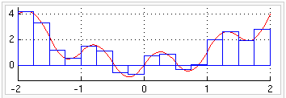
Numerical integration
Midpoint rule
IPMs discretize for numerical integration
Notes:
Matrix models assign stages based on life history or an algorithm (e.g. Vandermeer 1978)

Slide 46
Numerical integration
Evaluate kernel at midpoint of each cell to obtain a large matrix
Notes:
Now all the matrix algebra tools can be applied to the kernel

Slide 47
Numerical integration
Evaluate kernel at midpoint of each cell to obtain a large matrix
Notes:
Now all the matrix algebra tools can be applied to the kernel

Slide 48
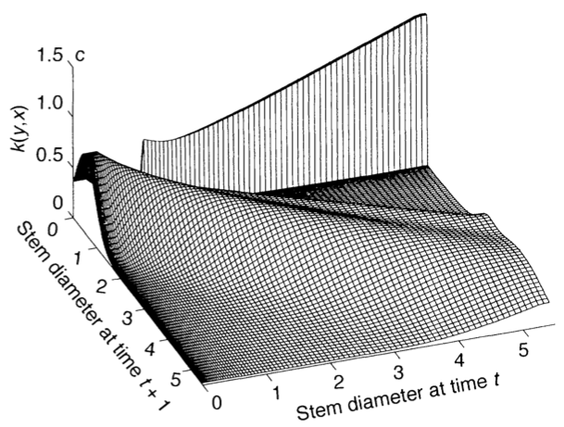
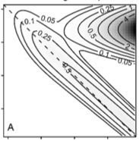
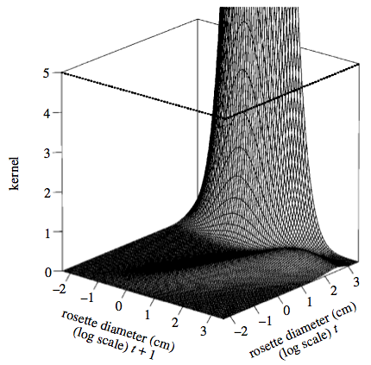
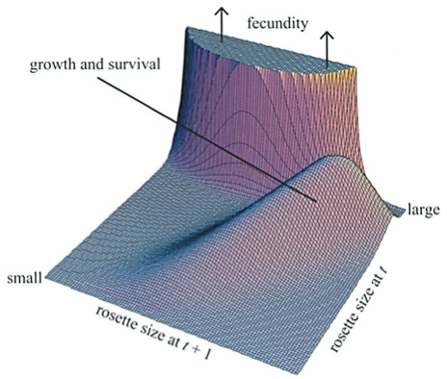
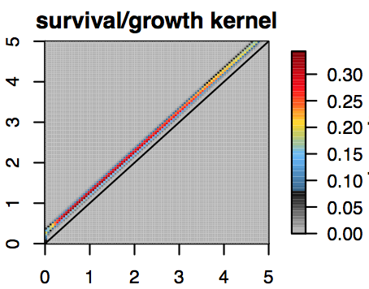
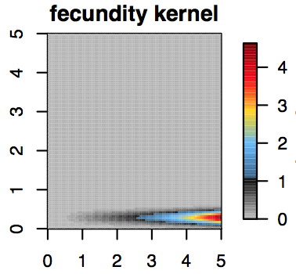
Full kernel function
~Nicolé et al. 2011
Easterling et al. 2000
Dalgliesh et al. 2011
Rees et al. 2002
Godfray et al. 2002
Merow et al. 2014

Slide 49
Analysis
Kernel
Notes:
But we can do more than this; that’s part of the reason IPMs are cool

Slide 50
Summary - Why IPMs?
Process-based demography
Continuous stages
Heterogeneity among individuals
Decompose life history to desired level of detail
Built on regressions and matrices

Slide 51
Summary - Why IPMs?
Process-based demography
Continuous stages
Heterogeneity among individuals
Decompose life history to desired level of detail
Built on regressions and matrices
Questions?

Slide 52
Exercises
Introductory exercises*
Data set: ‘Intro_to_IPMs_exercises_data.csv’
R script: ‘Intro_to_IPMs_exercises.r’
Work through the sample code in the R script
Ask us lots of questions
When finished make sure you’ve downloaded the latest version of IPMpack
install.packages("IPMpack")
libaray(IPMpack) # load the library
vignette('IPMpack_Vignette') # to open the vignette
* This code does not rely on IPMpack, and is meant to illustrate its underlying operations for a very simple case.

